Slide 1

SPARC Proposal and Installation

Slide 2
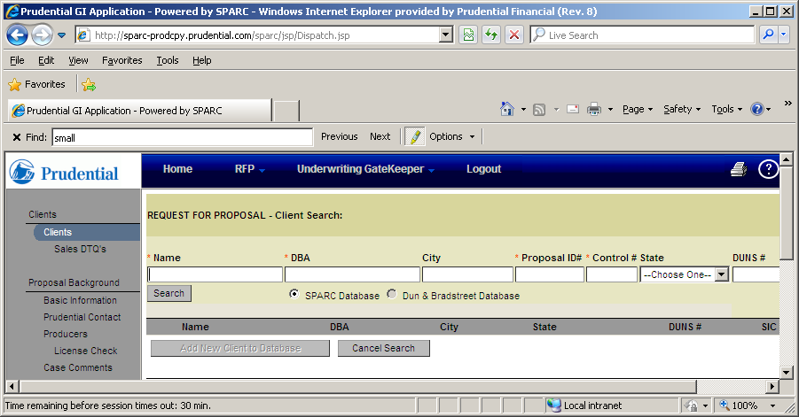
RFP
RFP (Request for Proposal) is the proposal portion of SPARC.
The proposal process is initiated by Link2GI (Mid/Large Market) or Epiphany (Small Market)
RFP is very different for Mid/Large cases and Small Market cases
For small market cases RFP contains detailed plan designs, client information, broker information and detailed rates
For Mid/Large cases RFP contains client information and high level rate information until the proposal sells

Slide 3
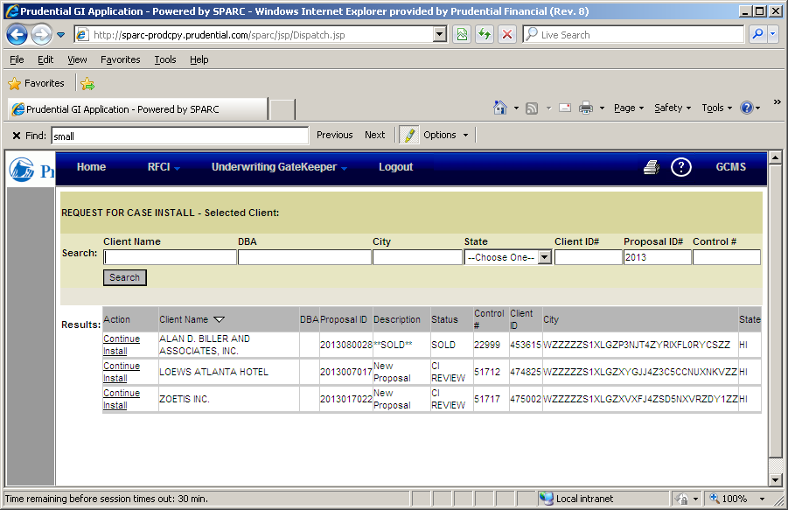
RFCI
RFCI (Request for Case Installation) is the case installation portion of SPARC
During RFCI Prudential captures all of the details necessary to administer the case:
client contacts
detailed locations
financial and claim structure
Cases only pass through RFCI once. Any changes post sale are done in the PIA portion of SPARC

Slide 4
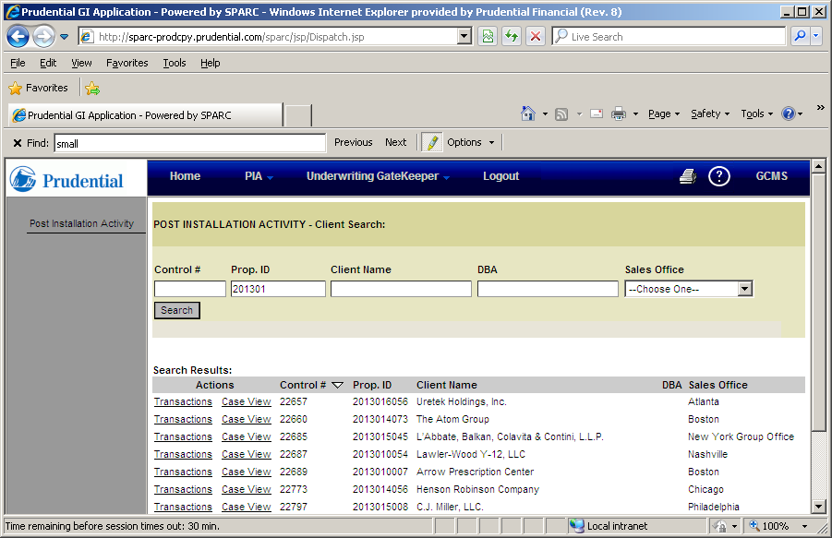
PIA
PIA (Post Installation Activities) is the case maintenance portion of SPARC
All case maintenance is done through transactions within PIA.
Changes are not done by submitting another proposal and installing it
There are 5 main types of transactions
Plan design changes (Updates to the plan design)
Administrative changes (Updates to contacts , addresses client record etc.
Lapses
Reinstatements
Renewals

Slide 5
RFP: Request for Proposal

Slide 6
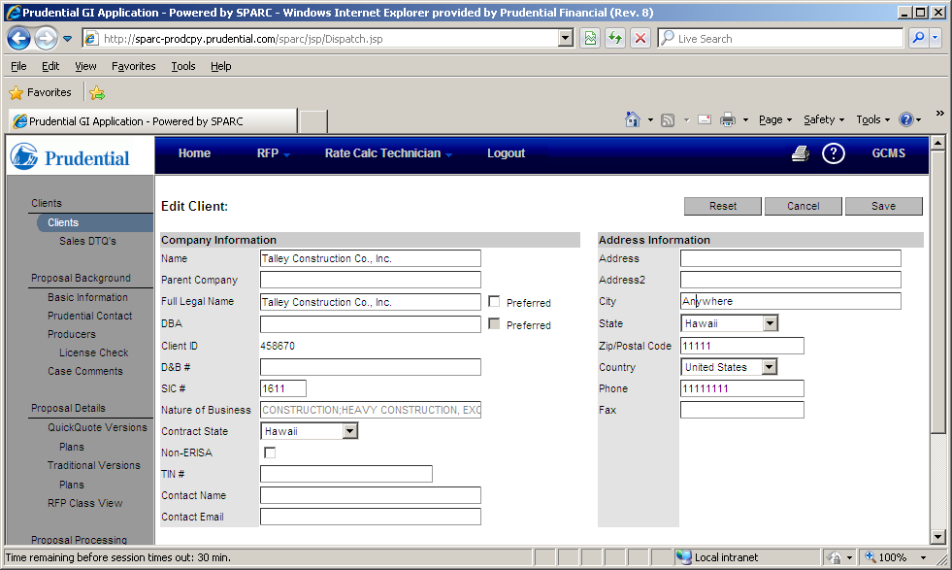
Client Screen
The Client screen captures high level information about the client
Ex. Name, SIC Code, Zipcode, State
Generally populated by the LINK2GI/Epiphany System (Sales Customer Relationship Management Systems
Each Client record can have multiple proposals associated to it

Slide 7
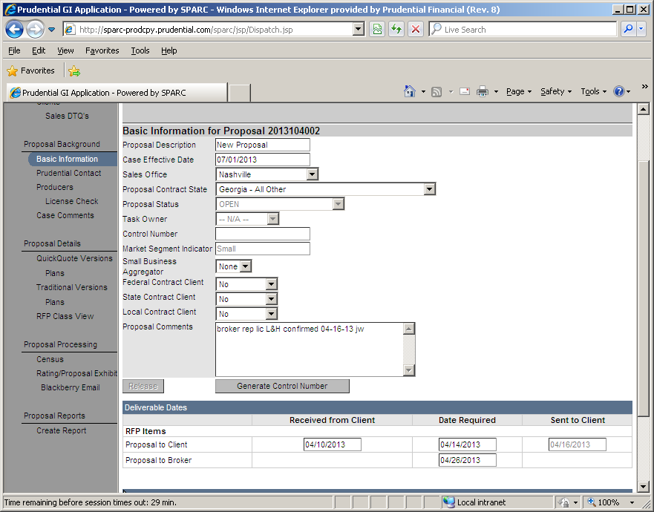
Basic Information Screen
This is the first screen in the proposal.
The screen captures high level effective dates and delivery dates for the proposal
Proposal ID is assigned

Slide 8
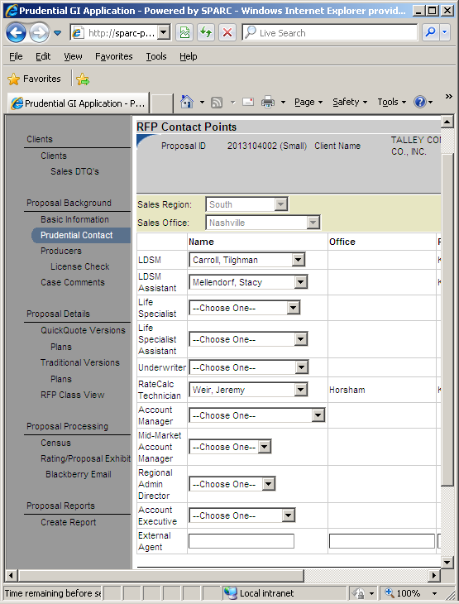
Prudential Contact Screen
Captures the people within Prudential who are working on the Proposal
The SPARC Workflow will route the proposal to the people specified on this screen

Slide 9
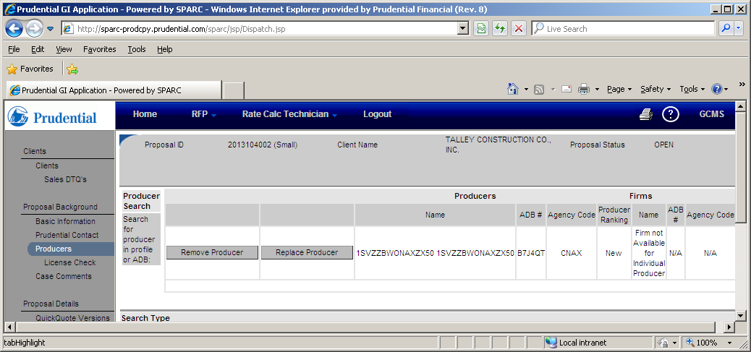
Producer Screen
Captures the producer associated to the proposal.
The producer is selected from a search of the corporate Agency Database (ADB)
For small market proposals commissions cannot be attached without a producer
This screen is not generally filled out for mid/large proposals

Slide 10
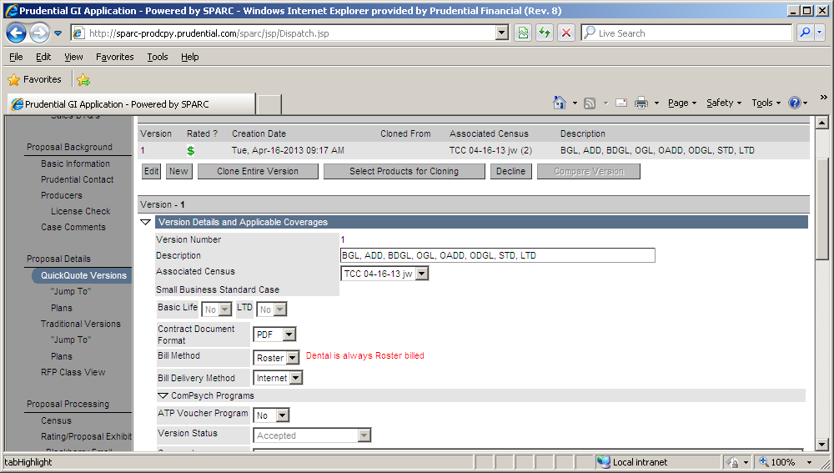
Version Screen (Part 1)
SPARC allows different variations to be quoted .
Ex. Employer wants to see a 50% LTD and a 60% LTD to decide which benefit is better for the company
The version screen allows the different variations to be maintained.
While this screen is used for all proposals multiple variations (Versions) are only captured for small market

Slide 11
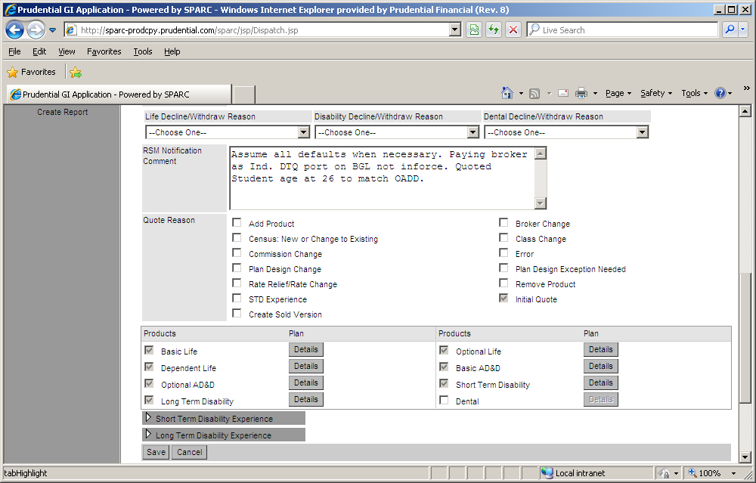
Version Screen (Part 2)
Within each version products are added (Small market Only)
The Version screen also captures several reason codes for :
Declines,
Proposal score
Quote reason

Slide 12
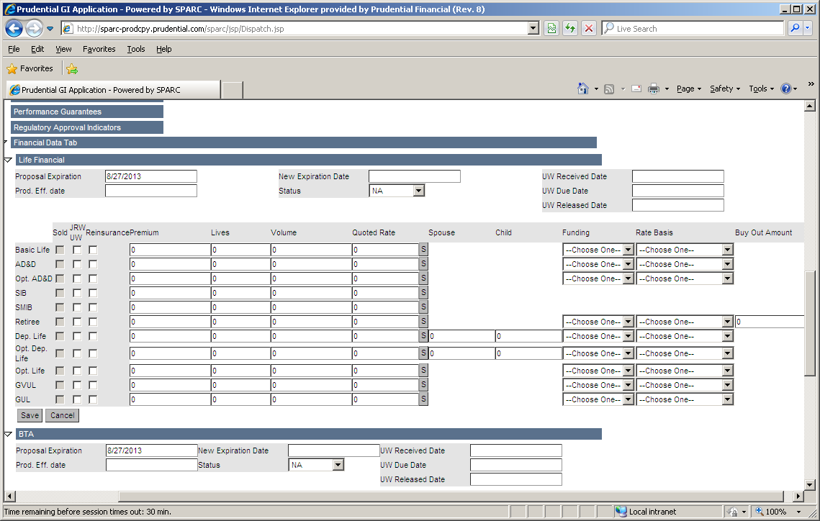
Version Screen (Part 3)
For mid/large market proposals plan designs and multiple versions are not captured until the case sells
For mid/large proposals high level financial data is captured for each quoted product

Slide 13
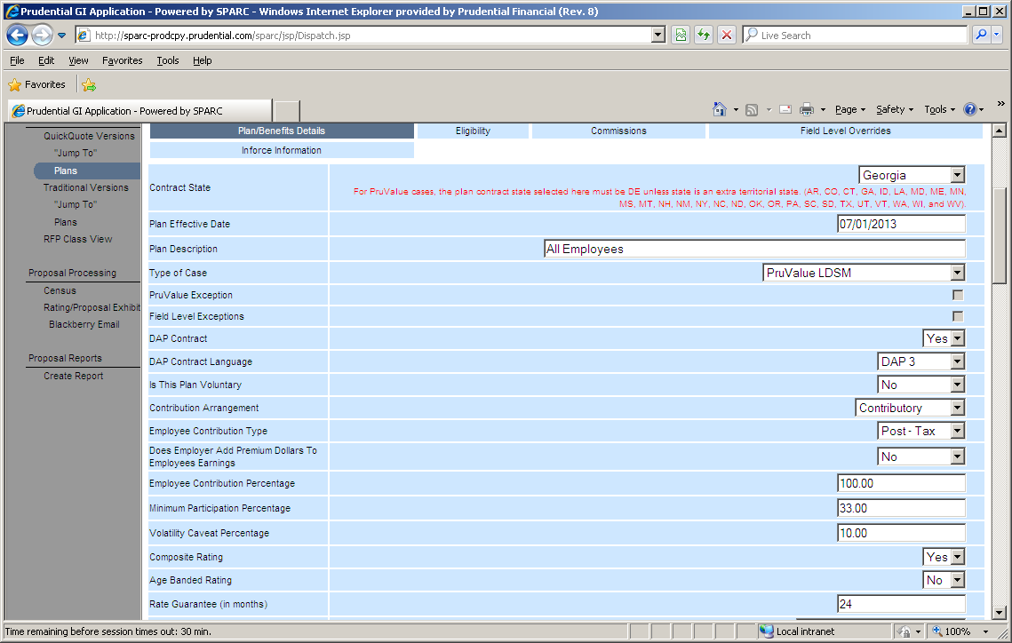
STD Product Quote Version (Part 1)
The SPARC plan design is only populated during the proposal process for small market proposals.
SPARC has 2 different views of the plan design for each product.
Quote view with all fields that feed the proposal exhibit and rating engine
An install version which adds administrative fields and the fields needed for Downstream systems

Slide 14
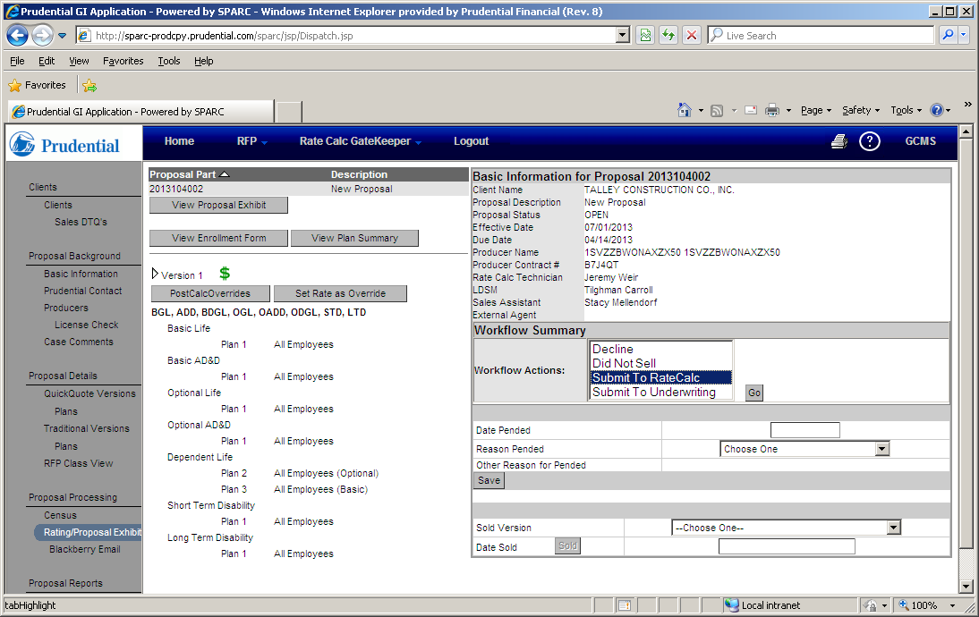
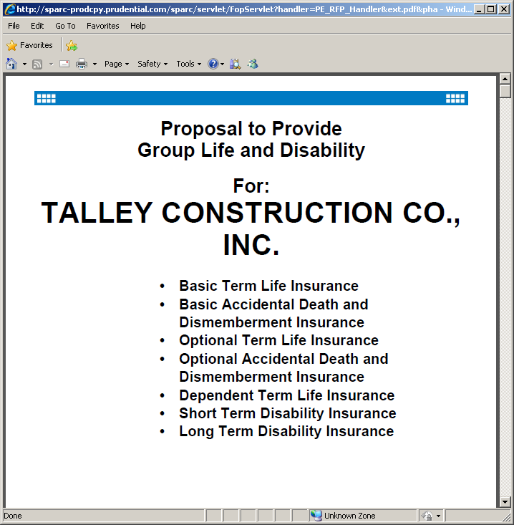

Rating and Workflow screen
The SPARC Rating and workflow screen is where:
Small rasers (Mostly Ratecalc) rate the case,
Small market users produce proposal and enrollment documents
All users move the case through workflow
Once the Proposal is completed by Ratecalc/Underwriting it is returned to sales
If the proposal is sold sales will send the proposal back ratecalc (small market) or Case Installation Management (Mid/Large Market)

Slide 15
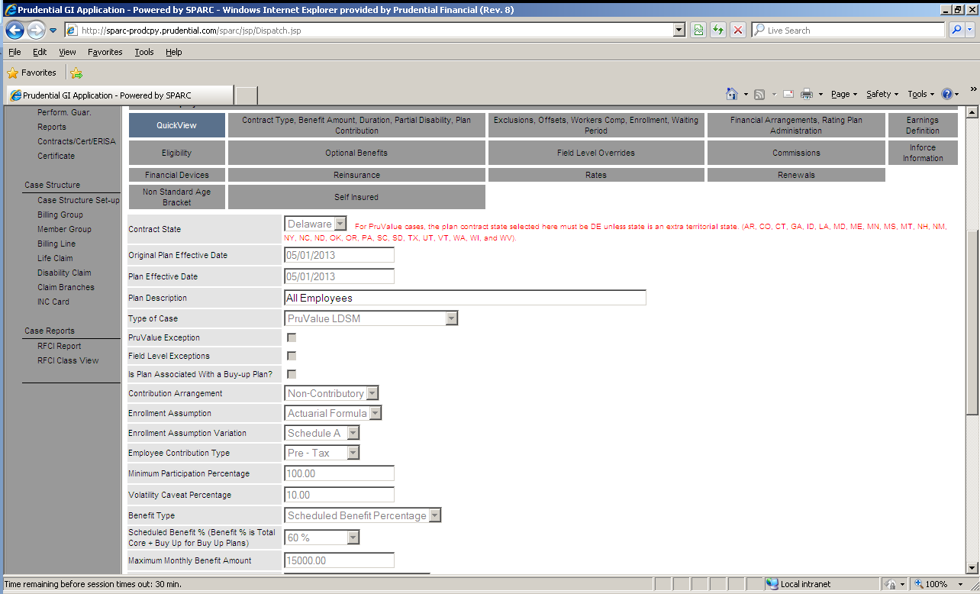
Case Install Plan Capture
After the case moves to the installation team the more complete version of the plan design is filled out in the RFP portion of SPARC
Each tab in the plan design is completed

Slide 16
Rating and Workflow Screen
For small market cases a final rating with an updated census will occur. For Mid/Large market the rates are captured
Once the Case is in good shape it is moved through the workflow from the RFP portion of SPARC to RFCI

Slide 17
RFCI: Request for Case Installation

Slide 18
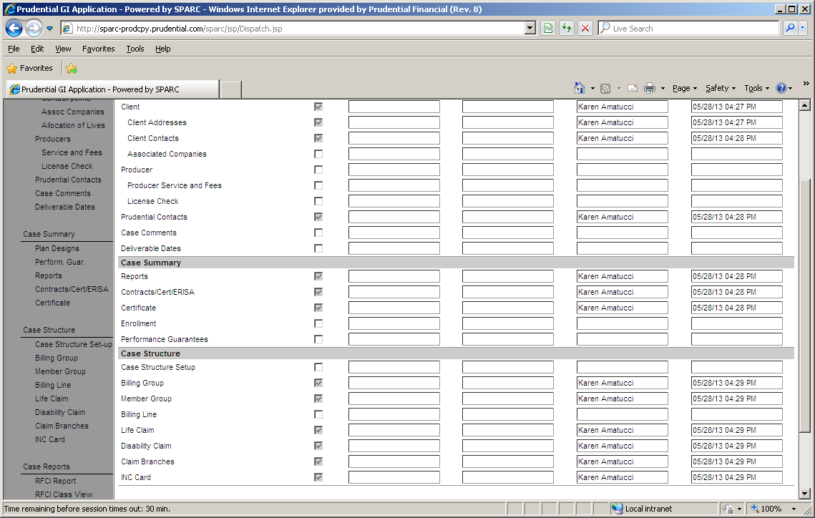
RFCI Status Screen
This is the status screen in RFCI it shows how the case is progressing through the installation process.
Each checkbox is a screen in the RFCI process.
All of the grayed out boxes are required

Slide 19
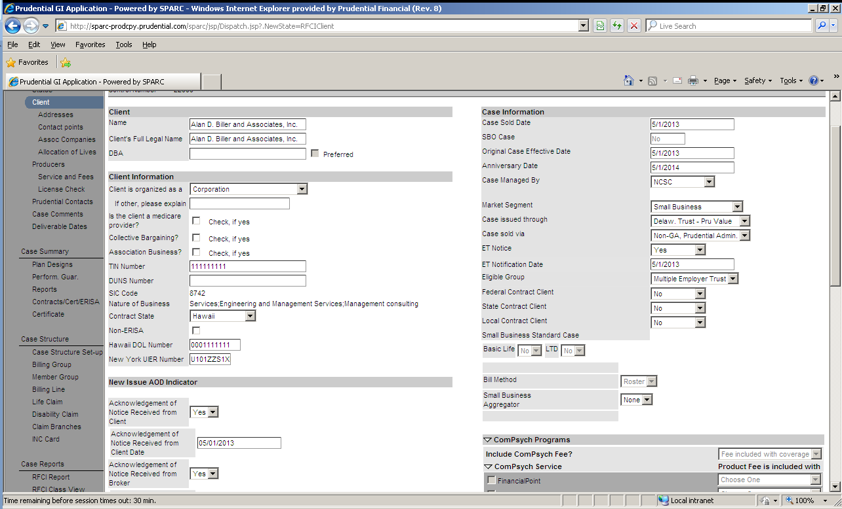
Client Screen
The Client screen captures information about the client
Name
TIN
Market Segment
Trust indicator

Slide 20
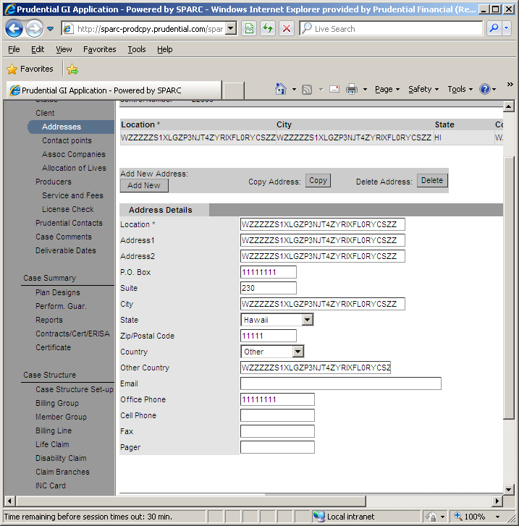
Address Screen
The Address screen captures the client locations
City,
Street
State
Zip etc.

Slide 21
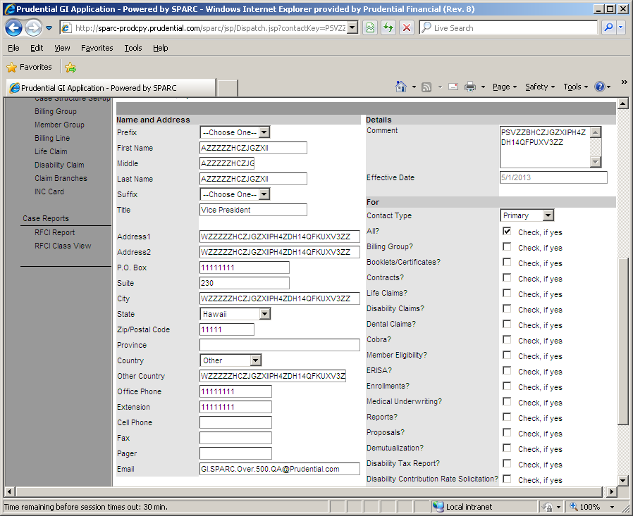
Client Contact Screen
The Client Contact screen captures information about the contacts at the company
Name
Address
Title
Contact Type
Billing
Claim etc.

Slide 22
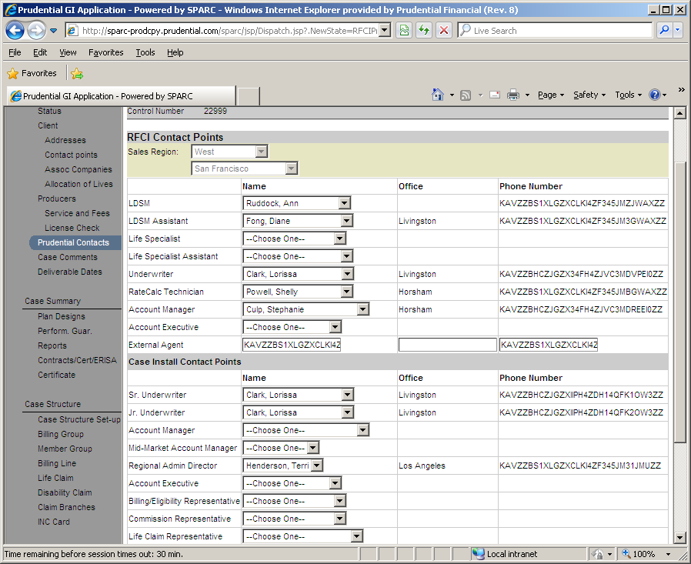
Prudential Contact Screen
The Prudential Contact screen captures information about the contacts within Prudential

Slide 23
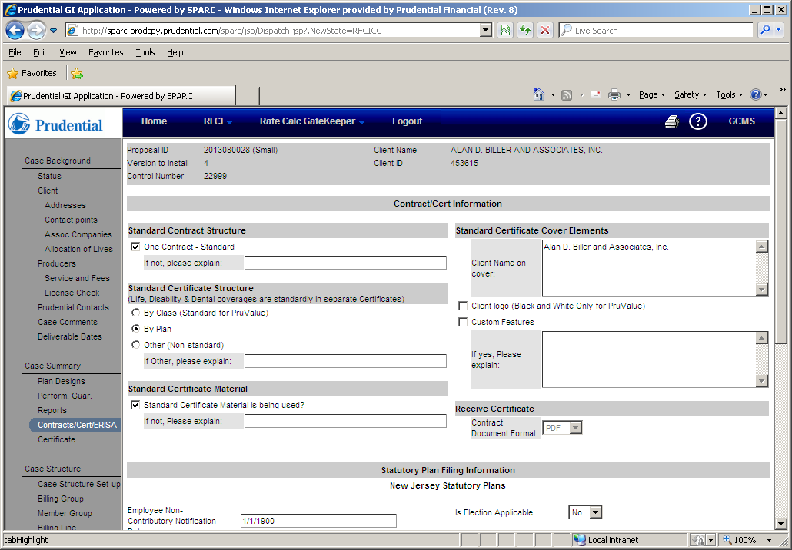
Contract, Cert, ERISA Screen
The Contract Cert ERISA screen sets up the structure that the client wants the contracts delivered to them in and captures ERISA information

Slide 24
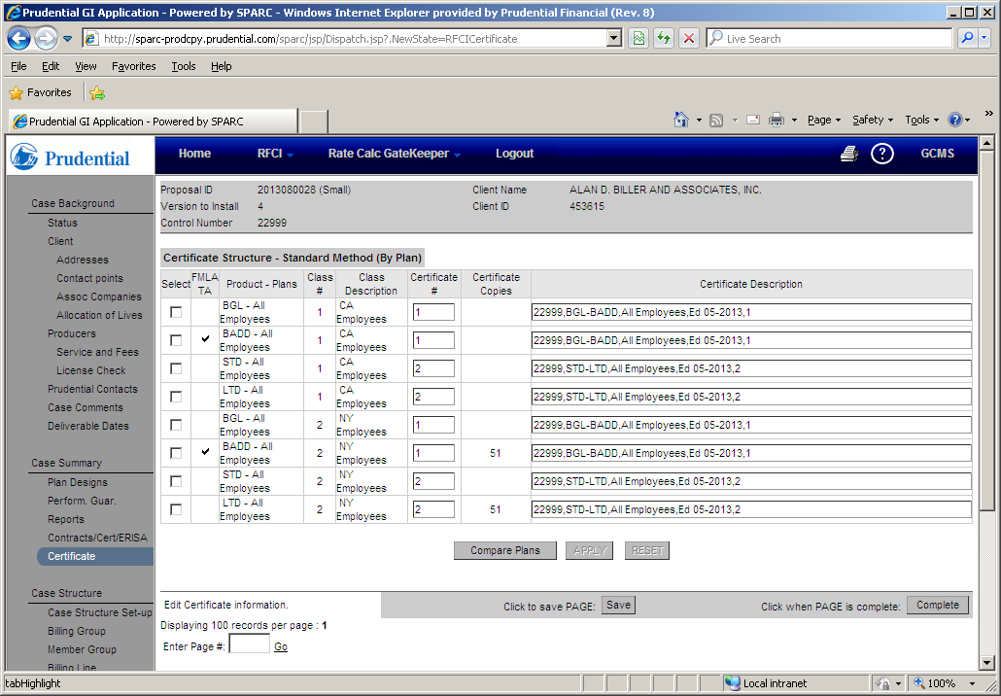
Certificate Screen
The Certificate screen shows the actual grouping of the certificates based on the information on the contract, Cert ERISA screen
Displays the actual plans and certificate edition numbers for each cert

Slide 25
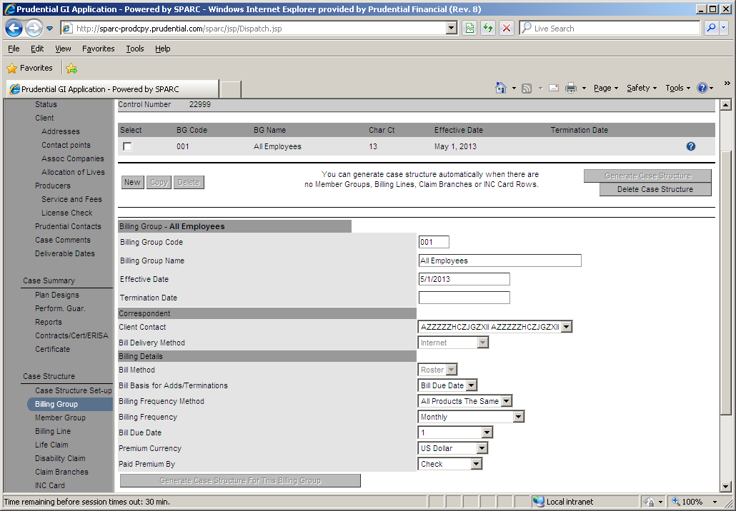
Bill Group Screen
The Bill Group screen is the start of the billing financial structure
Bill Groups translate directly to bills that will be delivered to the client
If there is 1 Bill group there will be 1 Bill. If there are 2 bill groups there will be 2 Bills
This screen allows plans to be assigned to the bill group

Slide 26
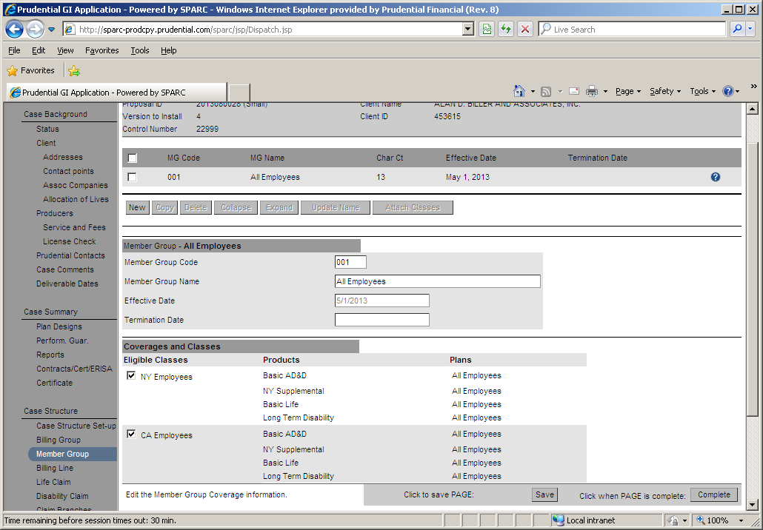
Member Group Screen
The Member Group screen is the grouping of employees who receive a set of benefits which will be displayed on the bill
Each member group represents a distinct set of employees
Each coverage the employee is eligible for is displayed for the member group
Each member group is assigned to a bill group
Member Groups are only used for Roster billed clients

Slide 27
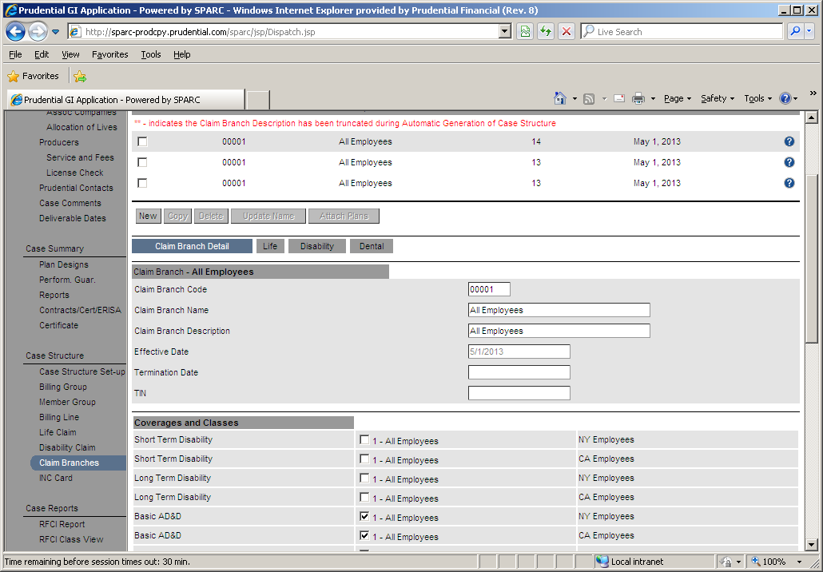
Claim Branch Screen
The Claim Branch screen s the grouping of products/plans which have a unique claim administration and meet the client’s claim reporting needs
Within the claim systems all products and plans are grouped under claim branches.
Each claim branch has a unique benefit setup (PDR in DCMS/LCMS) which is used to pay the claim.

Slide 28
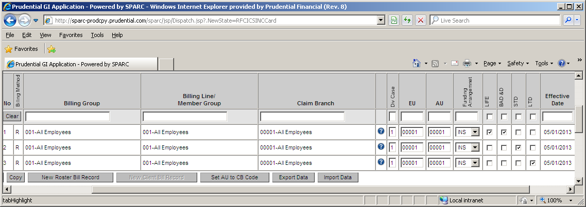
INC Card Screen
The INC Card shows a consolidated view of all of the case structure elements

Slide 29
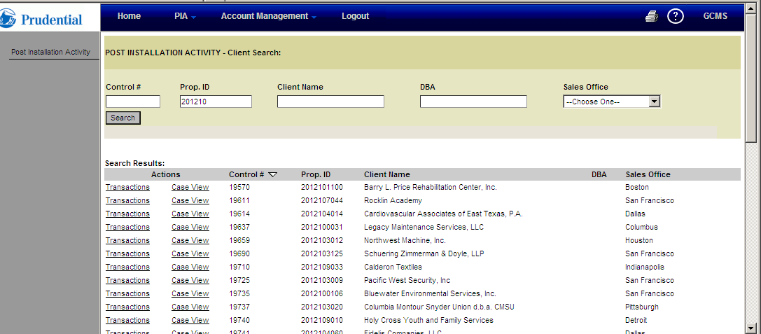
PIA Search Screen
PIA stands for Post Installation Activities
All changes to the case post first sale are performed in PIA
Changes to cases do not flow through the RFP/RFCI process
The PIA Search screen allows user to find cases in PIA

Slide 30
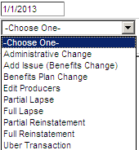
Transaction Types
Changes to cases in PIA are performed through transactions there are a few types of transactions (Full List above)
Plan Change transactions which update plan provisions (Benefit Plan Change) or add Plans (Add Issue)
Administrative Transactions which update all non plan features
Lapse transactions which lapse plans or the entire case
Reinstatement transactions which reverse lapse transactions
Edit producer transactions which change producers
Renewal transactions which update rates

Slide 31
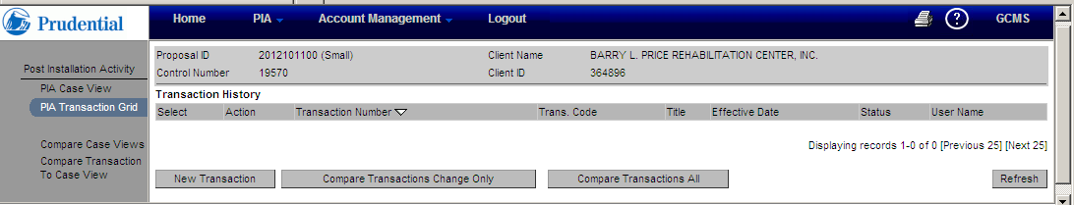
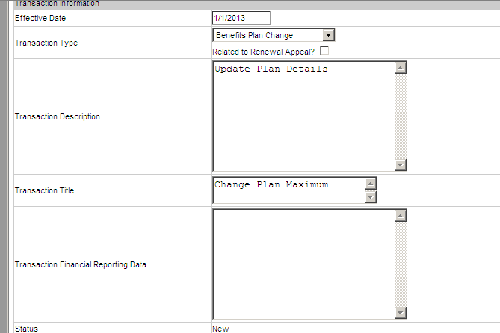
Starting a transaction
This is the screen where transactions are started
The Transaction type, effective date, title and comments are captured

Slide 32
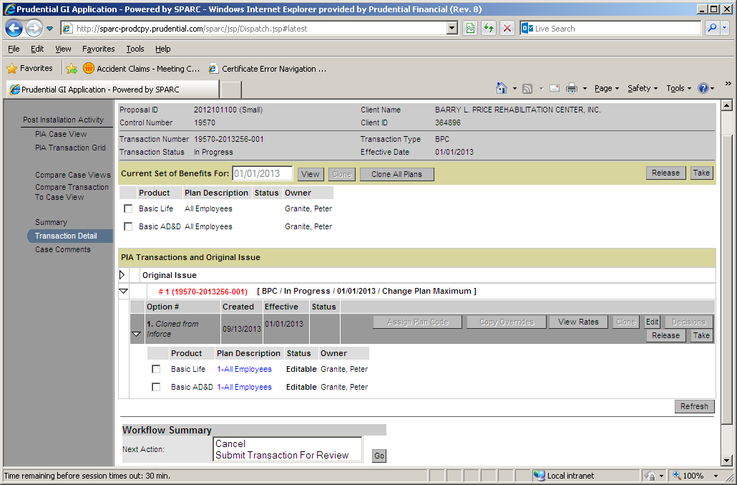
Cloning an Option
Once the transaction has started users select the products and plans they want to modify
Users can only modify the plans they have selected

Slide 33
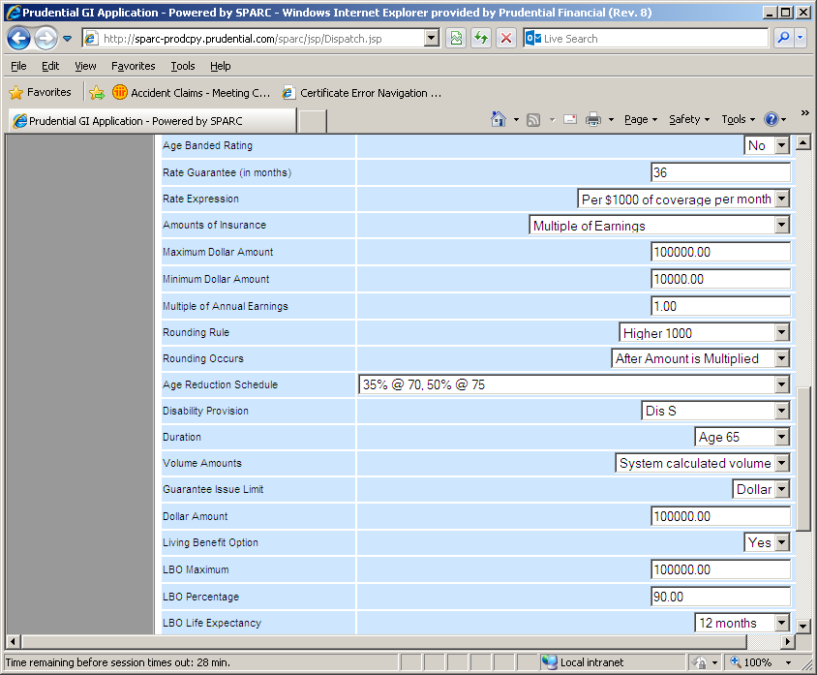
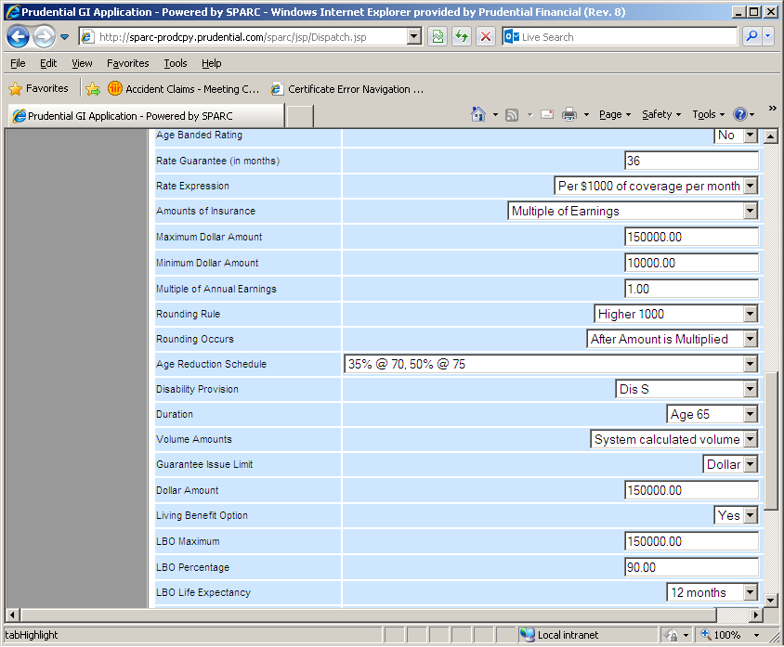
Plan Design Editing
Once inside the plan the editing is the same as within RFP

Slide 34
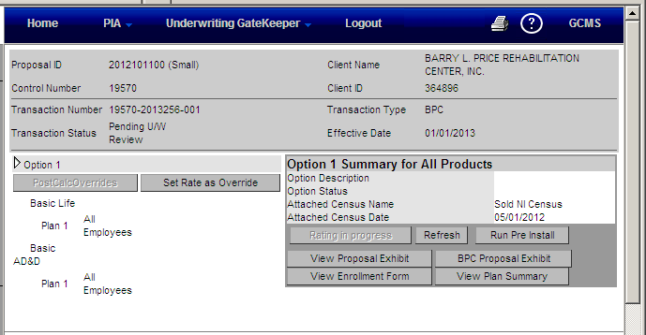
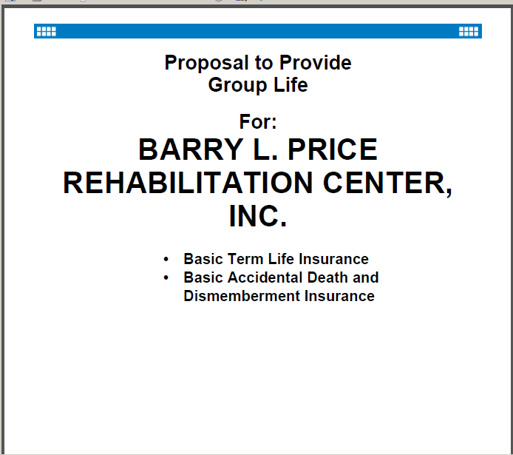
Rating
After the plans have been configured they can be rated
The rating process is the same as during the proposal phase and the same proposal and enrollment documents are produced

Slide 35
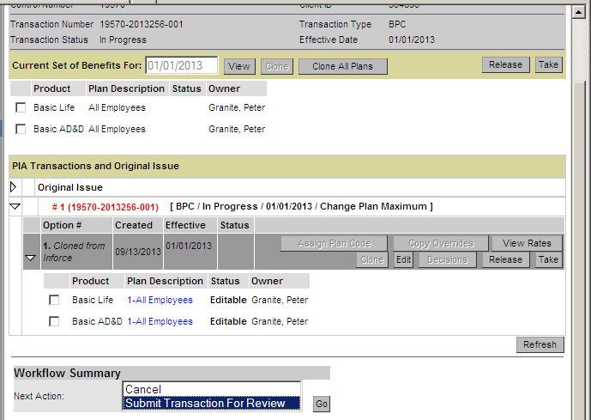
Workflow
This is the workflow screen it allows the user to route the transaction to the appropriate user
Once the account manager has started the transaction is routed to the underwriter
Once the underwriter has completed their work the transaction is routed back to the account manager
Transactions which do not require any approval have a completed selection

Slide 36
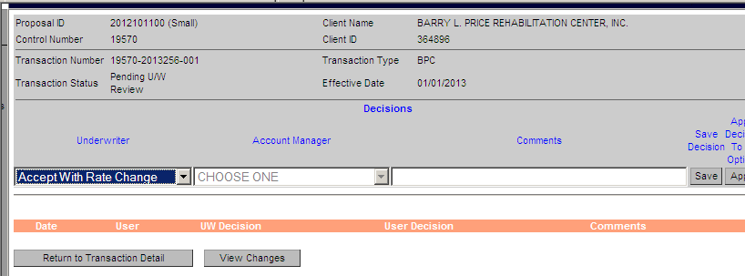
Decisions
The decision screen captures the decisions the underwriter and account manager make on the transaction
Underwriters can
Accept with rate change which puts any rating done in the transaction inforce (assuming AM approves)
Accept without rate change which puts the rates prior to the transaction back in place (assuming AM approves)
Decline which means the underwriter does not feel the transaction should move forward
Account managers can
Accept which makes the case ready to sell
Return to underwriting which sends the case back to underwriting
Decline closes the transaction
Withdraw closes the transaction

Slide 37
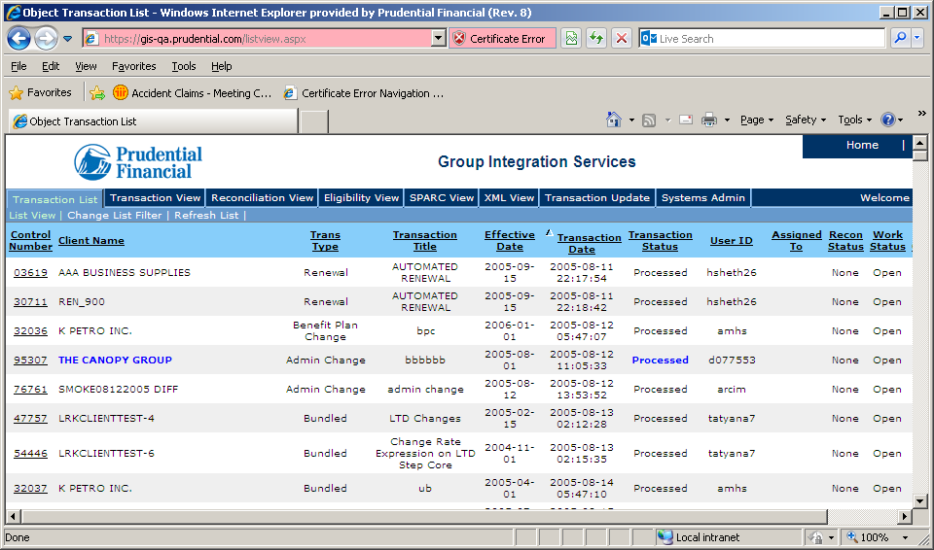
GIS Transaction List
The GIS transaction list shows all of the transactions that have been sent to a given application

Slide 38
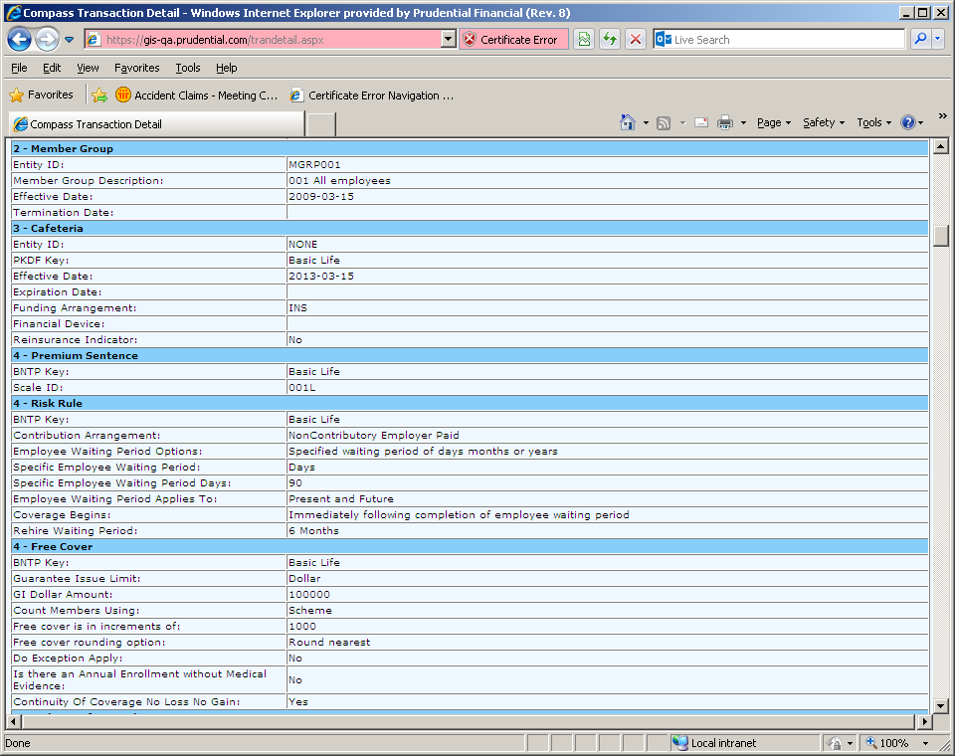
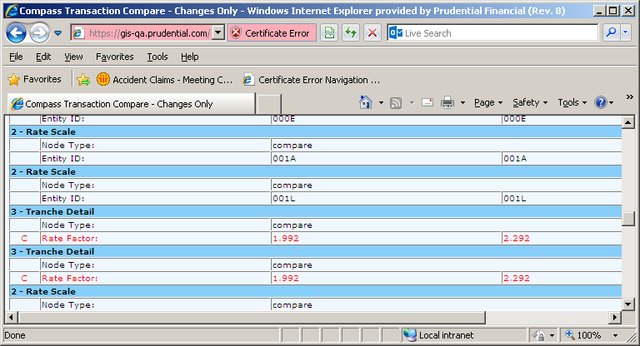
GIS Translated Data
The GIS translated data shows all of the data elements that have been sent to a system in the language and format expected by that system
These screenshots show 2 views on the left all of the data
On the right the changes only report which shows the updates to the data
This is a renewal transaction where only the rate changed

Slide 39
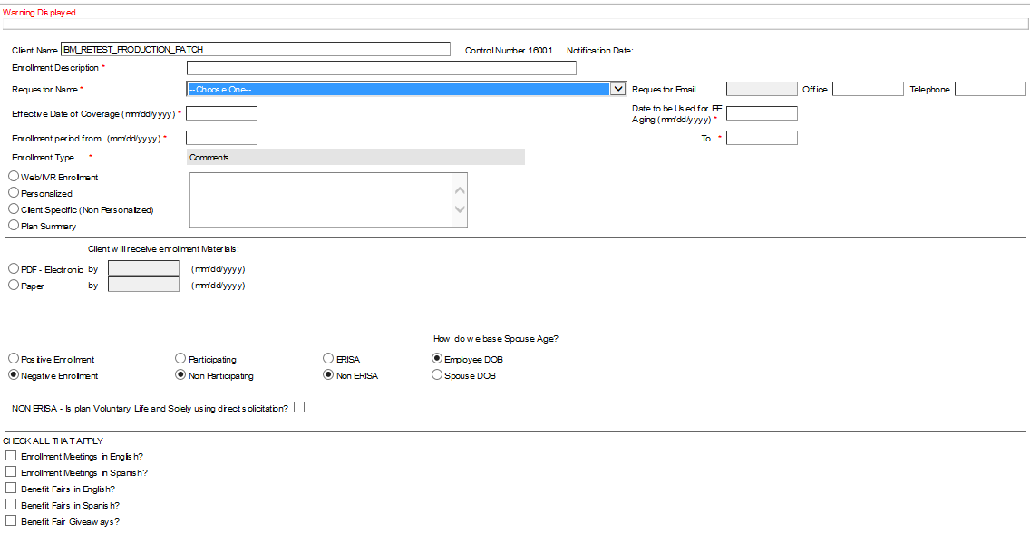
Enrollment Communication Request Screen

Slide 40
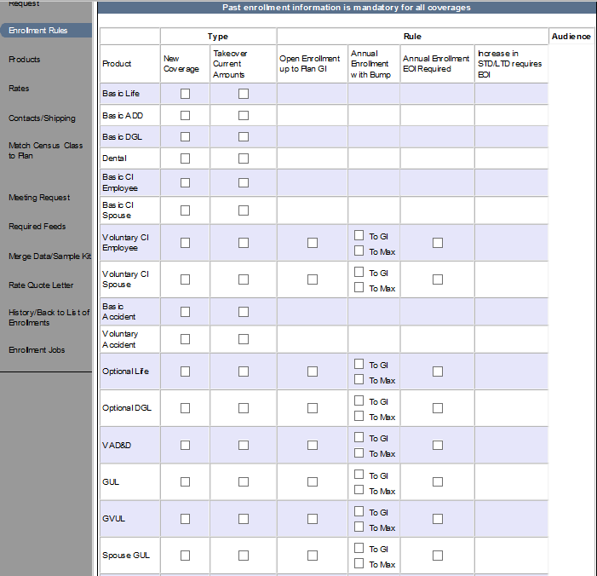
Enrollment: Enrollment Rules

Slide 41
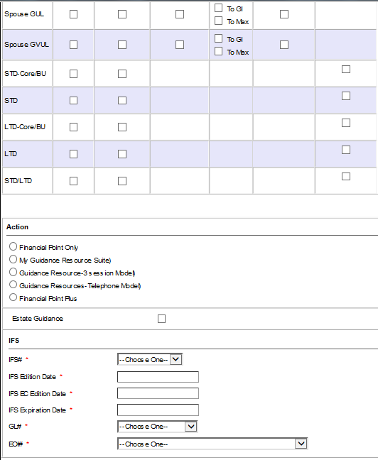
Enrollment Enrollment Rules Screen

Slide 42
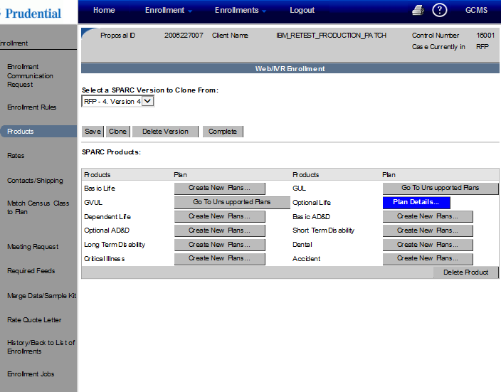
Enrollment Products Screen

Slide 43
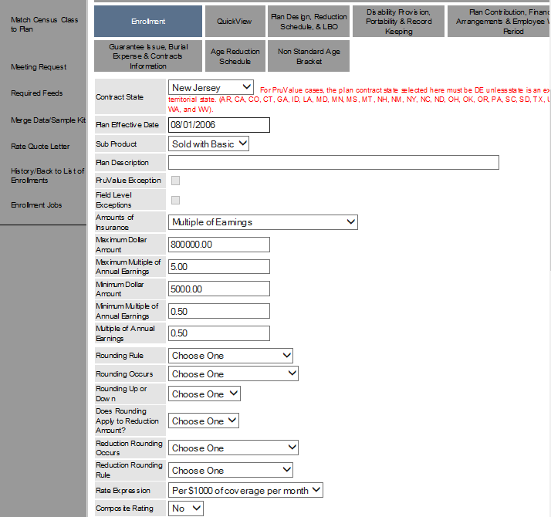
Enrollment Tab in product

Slide 44
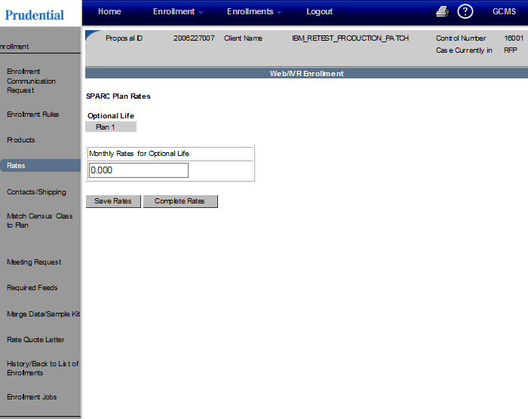
Enrollment Rate Screen

Slide 45
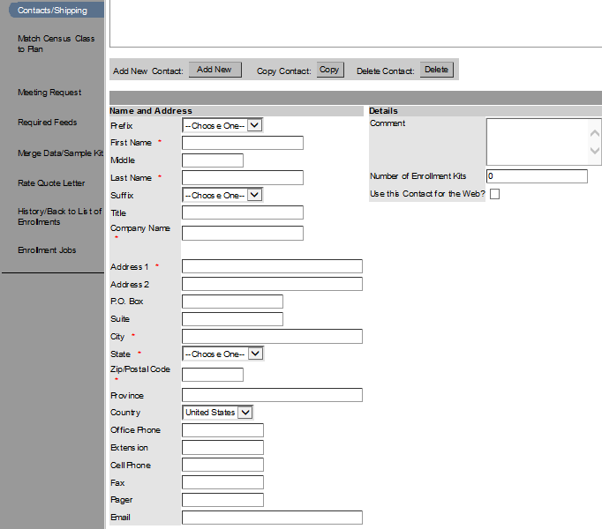
Enrollment Contact Screen

Slide 46
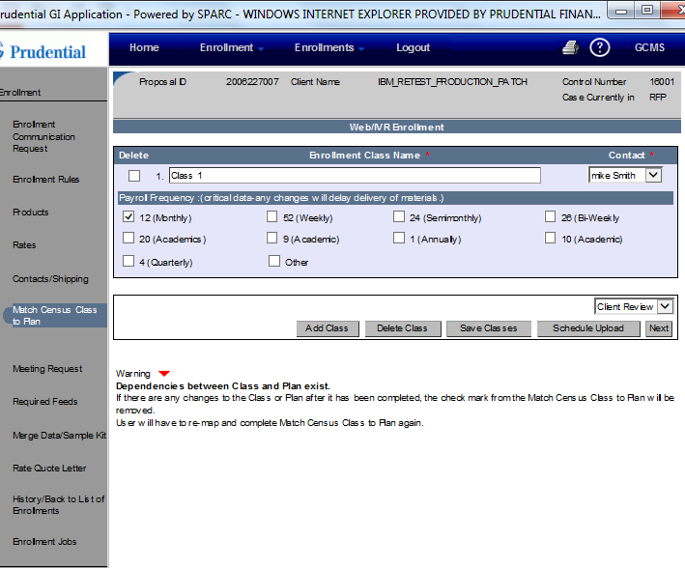
Enrollment Class Setup

Slide 47
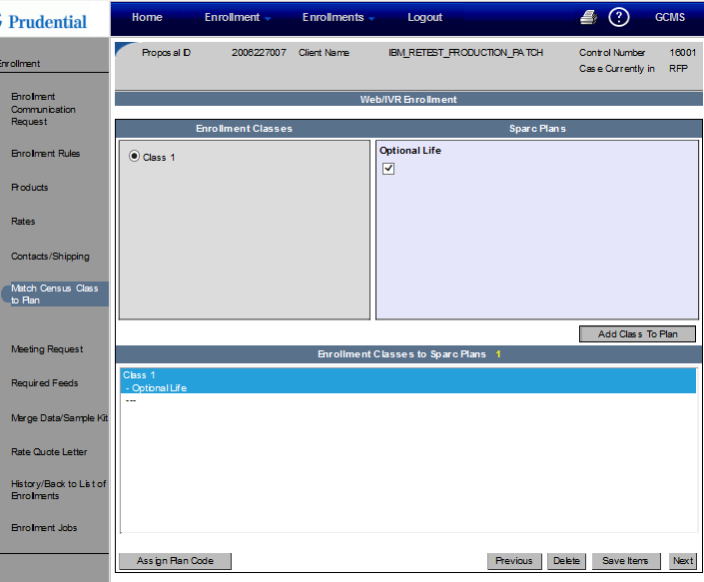
Enrollment Class to plan mapping

Slide 48
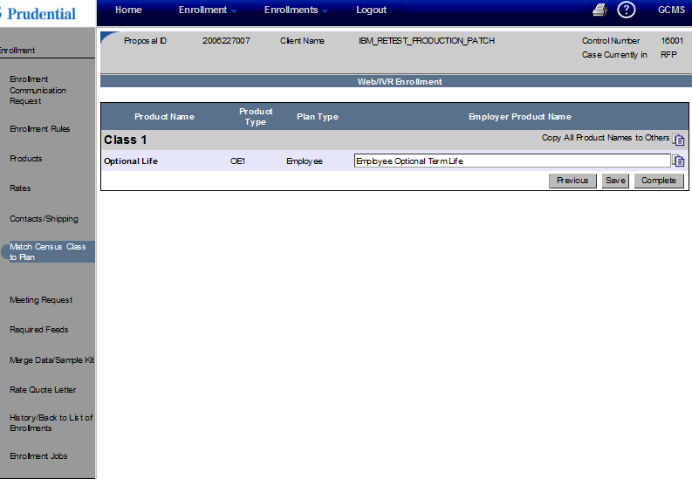
Enrollment Product name screen

Slide 49
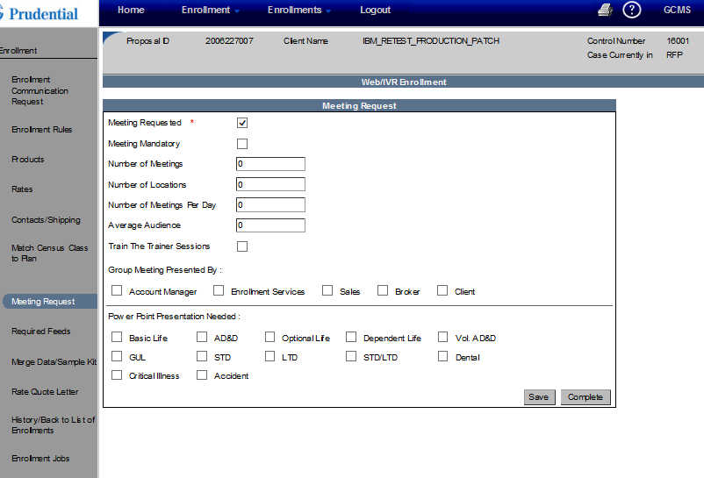
Enrollment Meeting Request

Slide 50

Enrollment Merge Data Sample Kit

